Slide 1


mankiw's macroeconomics modules
®
A PowerPoint™Tutorial
to Accompany macroeconomics, 5th ed.
N. Gregory Mankiw
The Data of Macroeconomics

Slide 2





GDP, CPI and Unemployment
Gross Domestic Product (GDP) is the market value of all final goods and services produced within an economy in a given period of time.
The consumer price index (CPI) measures the level of prices.
The unemployment rate tells us the fraction of workers who are unemployed.

Slide 3

Income, Expenditure
And the Circular Flow
There are 2 ways
of viewing GDP
Total income of everyone in the economy
Total expenditure on the economy’s
output of goods and services
Income $
Labor
Households
Firms
Goods
Expenditure $
For the economy as a whole, income must equal expenditure.
GDP measures the flow of dollars in this economy.

Slide 4


Rules for Computing GDP
1) To compute the total value of different goods and services, the national income accounts use market prices.
Thus, if
$0.50
$1.00
GDP = (Price of apples × Quantity of apples)
+ (Price of oranges × Quantity of oranges)
= ($0.50 × 4) + ($1.00 × 3)
GDP = $5.00
2) Used goods are not included in the calculation of GDP.
3) The treatment of inventories depends on if the goods are stored or
if they spoil. If the goods are stored, their value is included in GDP.
If they spoil, GDP remains unchanged. When the goods are finally sold
out of inventory, they are considered used goods (and are not counted).

Slide 5
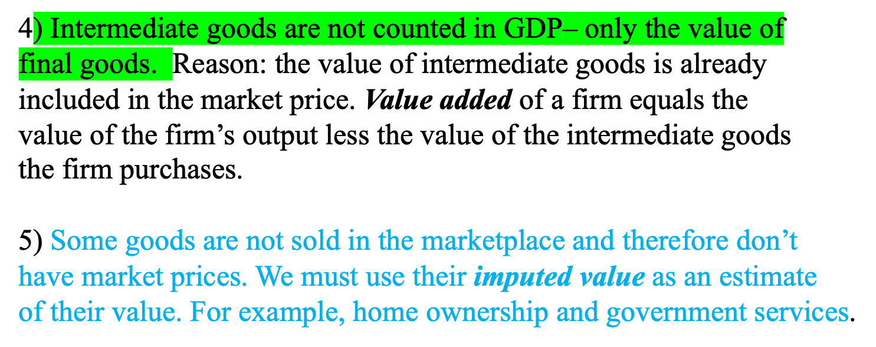

More Rules for Computing GDP

Slide 6
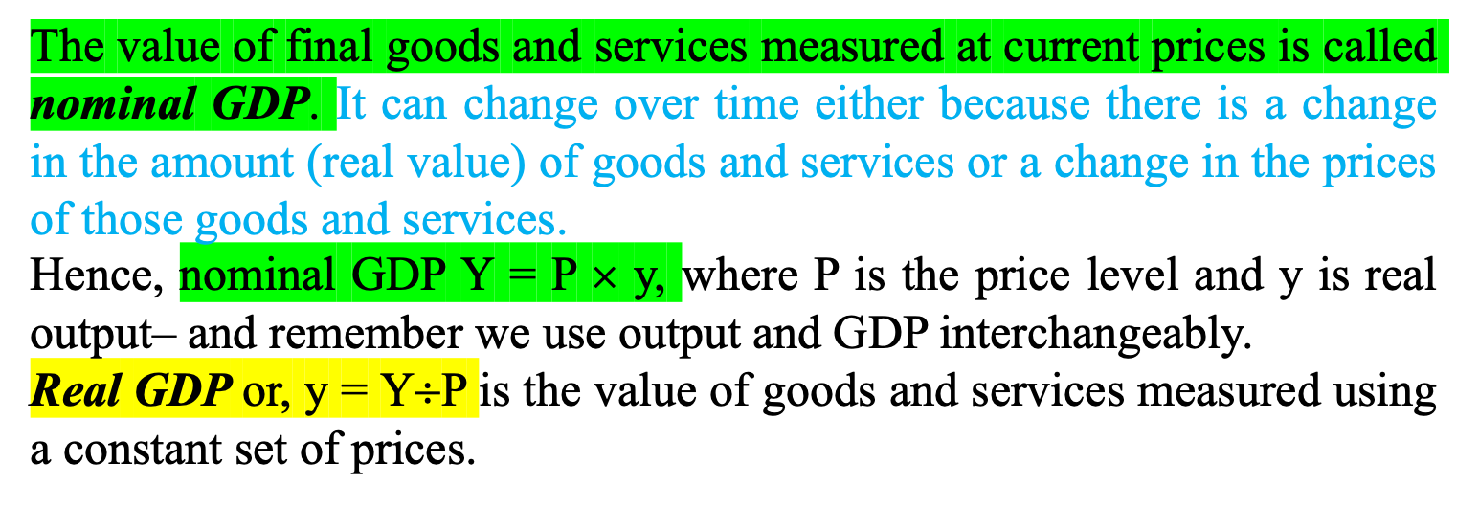
Real vs. Nominal GDP
This distinction between real and nominal can also be applied to other monetary values, like wages. Nominal (or money) wages can be denoted by W and decomposed into a real value (w) and a price variable (P). Hence, W = nominal wage = P • w
w = real wage = w/P
This conversion from nominal to real units allows us to eliminate the problems created by having a measuring stick (dollar value) that essentially changes length over time, as the price level changes.

Slide 7
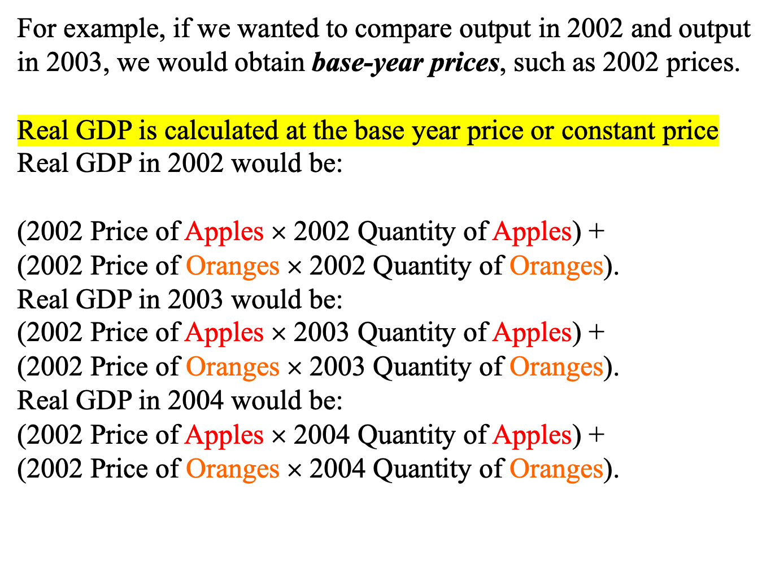
Let’s see how real GDP is computed in our apple and orange economy.

Slide 8
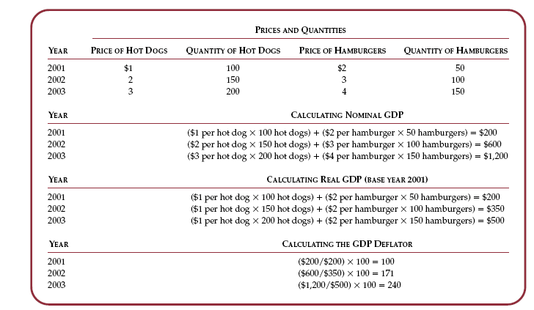

Slide 9
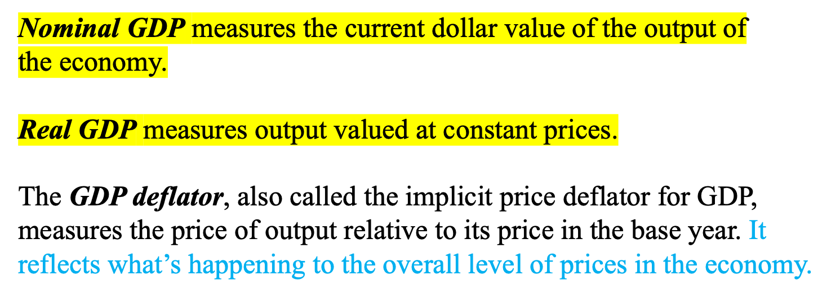
GDP Deflator
GDP Deflator = Nominal GDP *100
Real GDP

Slide 10

Components of Expenditure
Y = C + I + G + NX
Total demand
for domestic
output (GDP)
Investment
spending by
businesses and
households
is composed
of
Net exports
or net foreign
demand
Consumption
spending by
households
Government
purchases of goods
and services
This is the called the national income accounts identity.

Slide 11
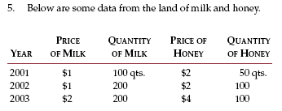


Slide 12
Other Measures of Income
To see how the alternative measures of income relate to one
another, we start with GDP and add or subtract various quantities.
To obtain gross national product (GNP), we add receipts of factor
income (wages, profit, and rent) from the rest of the world and
subtract payments of factor income to the rest of the world.
GNP = GDP+Factor Payments from Abroad -Factor Payments to Abroad
Whereas GDP measures the total income produced domestically, GNP
measures the total income earned by nationals (residents of a nation).
To obtain net national product (NNP), we subtract the depreciation of
capital-- the amount of the economy’s stock of plants, equipment, and
residential structures that wears out during the year:
NNP = GNP - Depreciation

Slide 13

Computing the CPI
The Consumer Price Index (CPI) turns the prices of many goods and services into a single index measuring the overall level of prices.

Slide 14
Let’s see how the CPI would be computed in our
apple and orange economy.
For example, suppose that the typical consumer buys 5 apples and 2 oranges every month. Then the basket of goods consists of 5 apples and 2 oranges, and the CPI is:
CPI= ( 5 × Current Price of Apples) + (2 × Current Price of Oranges)
( 5 × 2002 Price of Apples) + (2 × 2002 Price of Oranges)
In this CPI calculation, 2002 is the base year. The index tells how much it costs to buy 5 apples and 2 oranges in the current year relative to how much it cost to buy the same basket of fruit in 2002.

Slide 15
CPI Versus the GDP Deflator
The GDP deflator measures the prices of all goods produced, whereas the CPI measures prices of only the goods and services bought by consumers. Thus, an increase in the price of goods bought by firms or the government will show up in the GDP deflator but not in the CPI.
Also, another difference is that the GDP deflator includes only those goods and services produced domestically. Imported goods are not a part of GDP and therefore don’t show up in the GDP deflator.

Slide 16
Key Concepts of Ch. 2
Gross domestic product (GDP) Consumer Price Index (CPI) Unemployment Rate National income accounting Stocks and flows Value added Imputed value Nominal versus real GDP GDP deflator
National income accounts identity Consumption Investment Government Purchases Net Exports Labor force Labor-force participation rate

